Slide 1
Agenda
LOMOD Overview
Question & Answer
HUD Question & Answer
Meet & Greet 5th floor

Slide 2
LOMOD Overview TCA to PBCA

Slide 3
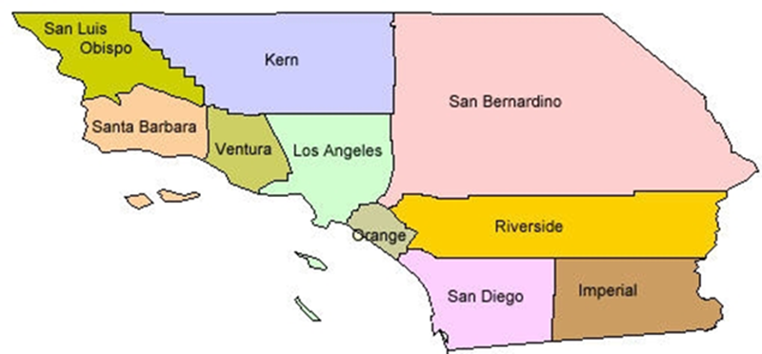
Established in 1973 by HACLA to provide Senior Housing
Mission: Provide Quality Customer Service & Accurate Contract Administration Services in partnership with local Owner/Agents and HUD
719 contracts totaling 49,395 units
Over $500 million annual Housing Assistance Payments
Receives Annual Compliance Review (ACR) by HUD
Disincentives for incorrect processing and missed deadlines

Slide 4
Performance Based Contract Administrator (PBCA)
The principal tasks of a PBCA under the Annual Contribution Contract (ACC) include, but are not limited to, the following:
Process contract renewals and rent adjustments, as required;
Process monthly vouchers to pay property owners accurately and timely;
Conduct Management and Occupancy Reviews;
Receive Tenant Concerns and act as a liaison between Tenants and Owners; and
Oversee the administrative tasks for HUD at a local level.

Slide 5
Departments
Resident Liaison
Compliance
Contracts
Vouchers
Quality Control
E3 Housing Solutions

Slide 6
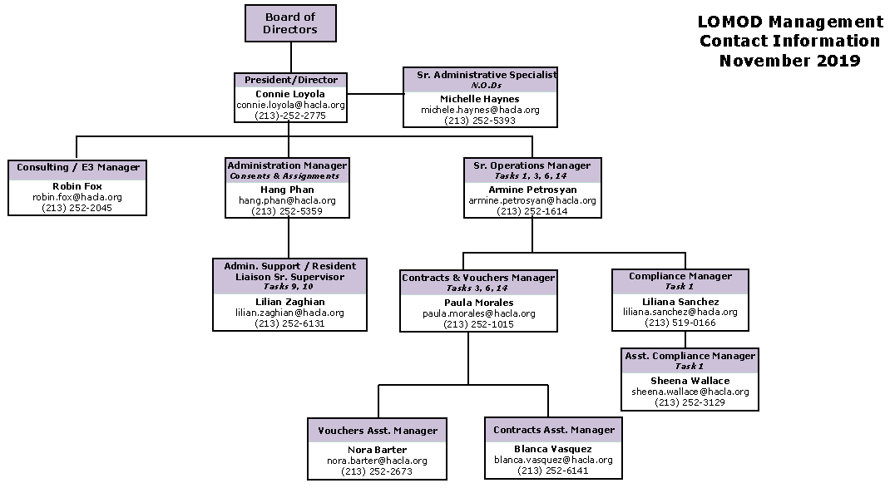

Slide 7
Vouchers/Special Claims
Verify and Certify accuracy of monthly Section 8 vouchers
Disburse Section 8 Payments to Owners
1st of the month – Large ACH payment
ACH system payments are released when notified by HUD
Vouchers must be submitted by the 10th of each month
If the voucher is received after the 10th of the month a late notice will be issued
If the property receives three late notices it will be a finding on the Management Occupancy Review

Slide 8
Vouchers/Special Claims
Verify and Authorize payment on valid Section 8 Special Claims for unpaid rent, resident damages or vacancy loss
Owner/Agents can appeal the decision by submitting a request to the PBCA in accordance with the Special Claims Processing Guide, June 2006
The owner/agent must appeal a denied or reduced claim within 30 calendar days from the date of the letter denying or reducing the claim, or the appeal will be denied. The appeal should include a brief explanation as to why the claim should be paid, along with any new or additional supporting documentation. The owner is allowed one original submission, one resubmission, and one appeal.
Appeals will not be processed for any special claims where the Owner/Agent has not been responsive.

Slide 9
Special Claims
Common Reasons for incomplete Submissions
•Missing Owner Signatures, date and phone number on HUD Form 52670-A Part 2, 5271-C and 52671-A
•Wrong Dates used to calculate claim amount
Tenants Move-out date
Unit ready for Occupancy
Move-in Date (Date unit was re-rented)
Incorrect contract rent
•Waitlist not in compliance
•Unable to determine if security deposit was collected
•All special claims must be submitted to SpecialClaims@hacla.org

Slide 10
Vouchers
Common Reasons for incomplete Submissions
•Incorrect contract and UA when gross rent changes are submitted
•Incorrect Certification effective date for Interims
•Missing/incorrect SSN Exception code (Item 45 on the 50059)
•Missing the basic and market rent for Section 236 properties
•Dual Subsidy, Tenants move-in dates conflicts with move-out at previous property

Slide 11
Contract Renewals / Rent Adjustments
Contract Renewals
Processed Annually, 120 days prior to Contract Expiration Date
Owners have 6 different contract options for renewal
Upon receipt of owner submission packet, LOMOD will determine if project is qualified for the option selected
Option determining factors include
Type of financing
Use and Regulatory Agreement
HAP Contract

Slide 12
Contract Renewals / Rent Adjustments
Rent Adjustments – processed annually
Utility Allowances
LOMOD reviews, processes and recommends to HUD amount to be paid to residents based on the HUD H-2015-04 Notice
Rent Comparability Studies
LOMOD conducts an initial review for compliance and forwards to an administrative appraiser for substantive review

Slide 13
Contract Renewals / Rent Adjustments
Rent Appeals
Owner may appeal rent adjustment decision
PBCA reviews 1st level appeal
HUD reviews 2nd level appeal if required
Owner/Agents can appeal the decision by submitting a request to the PBCA in accordance with the Section 8 Renewal Policy Guidebook, 2017, Chapter 9, Section 9-18

Slide 14
Contract Renewals / Rent Adjustments
Common Reasons for incomplete Submissions
•Missing Owner Signatures
•Wrong Dates used to calculate one-year and/or 30-day notices
•Language has been removed on Notices and Certifications
•Outdated HUD Forms used

Slide 15
Management and Occupancy Reports (MOR)
LA LOMOD conducts an annual on-site Management and Occupancy Review (MOR) of each assigned Section 8 project
The reviewer must evaluate, analyze or assess the owner’s operating policies, procedures, and practices related to compliance with the HAP Contract as set forth in regulations, handbooks, forms, notices, and guidance issued by HUD
Since 2007:
LA LOMOD has accurately completed over 3,100 MOR’s

Slide 16
Management and Occupancy Reports (MOR)
MOR consists of multiple parts:
Pre on-site visit desk review
On-Site visit to property
Review of Policy and Procedures
File Review
Inspection of Property
Report Writing
Difference: Excludes the Review of Addendum B

Slide 17
Management and Occupancy Reports (MOR)
Common MOR findings:
Not maintaining EIV reports (monthly, quarterly, annually printed reports)
Not maintaining EIV CAAF, UAAF, Rules of Behavior, Owner approval letter, Security Awareness Training certificates
Income miscalculations, make sure collect 4-6 consecutive paystubs and date stamp all verifications received
Do not forget to add Debit Card current balance as an Asset (debit card received from EDD, Public Assistance, Social Security, Employment)

Slide 18
Management and Occupancy Reports(MOR)
How to close an MOR:
Make sure you read Corrective Action listed on the MOR report. This will specify exactly what needs to be done to close the MOR report.
For core documents such as Tenant Selection Plan, House Rules, Waiting List, etc. please refer to the Checklists provided with the report. The Checklists specify exactly what is missing from the document.
Make sure to submit a response for each finding listed. Do Not skip any findings.
Make sure to respond within 30 days of when you receive the report.

Slide 19
Management and Occupancy Reports(MOR)
How to appeal an MOR rating for Below Average and Unsatisfactory:
Write down all the findings you are appealing and the reason. Make sure you provide supporting documents as proof why the finding was incorrect
Submit the appeal with supporting documents within 30 days of when you receive the report to Armine.Petrosyan@hacla.org

Slide 20
Resident Liaison (RL)
PBCA must accept resident complaints and follow-up with owners to ensure that owners take appropriate action
Life Threatening Health & Safety (within 1 hour)
Non-Life Threatening Health & Safety (within 2 business days)
General Inquires
RL tasks
Takes inquiries / calls
Notifies Owner and Management Agent
Follows-Up on open inquires (additional information)
Closes inquiries

Slide 21
Resident Liaison (RL)
Supporting documents to verify that Resident concerns noted on Initial Inquiry have been addressed:
Invoices
Work Orders
HUD – 50059’s
Photos of repairs
Statements from Owner/Agents
Tenant Notifications
Rent Roll
Verification of Employment

Slide 22
Quality Control
Performs Quality Control on all LOMOD work product
Contracts
Rent Adjustments
Vouchers
Special Claims
MORs
Monthly Invoice
Create, Submit and Respond to HUD
Review and Release of daily ACH payments to Owners
Reviews ACR Documents

Slide 23
Consents & Assignments
Consent of Assignment of HAP Contract
Security for the loan by the lender to the owner
Does not change the terms of the HAP Contract in any way and does not change the rights or obligations of HUD
Assignment, Assumption and Amendment Agreement of Section 8 HAP Contracts
Require when property being sold and subject to HAP contract
Seller agrees to sell the property and buyer agrees to purchase the property including without limitations, the improvements situated thereon and has agreed to accept the assignment of and assume all obligations under the HAP Contact

Slide 24
Consents & Assignments
Consent of Assignment of HAP Contract
Assignment, Assumption and Amendment Agreement of Section 8 HAP Contracts
Must submit to your HUD AE for approval prior to submitting to LOMOD
Do Not alter the Consent and Assignment of HAP; alterations will delay processing

Slide 25
E3 Housing Solutions provides leading-edge training and supportive services for affordable housing clients to enhance operational efficiency
How can we help you?

Slide 26
Training (any property):
MOR Training
HUD Compliance
Contract Renewals / Rent Adjustments
Voucher Processing
EIV
VAWA
Rent Calculation
Consulting (properties not with LOMOD):
Tenant File Reviews
Contract Renewal Processing
Annual Rent Adjustment
Utility Allowance Baseline

Slide 27
Questions & Answers

