Slide 1
L.A. LOMOD Update

Slide 2
PBCA contract update
Owner Portal
2020 Census

Slide 3
PBCA Contract Update
18 month extension from July 1 to December 31, 2020
MOR reviews to increase during 18 month period starting in July
Traditional Contract Administration and some HUD-administered properties will be reassigned to PBCAs

Slide 4
Owner Portal
Secure upload and download of documents
No file size limitation
Email confirmation of documents being sent
Check status of submissions
Need administrator for each management company

Slide 5
Owner Portal

Slide 6
Owner Portal

Slide 7
Owner Portal

Slide 8
Owner Portal

Slide 9
Owner Portal

Slide 10
Owner Portal

Slide 11
Owner Portal

Slide 12
Owner Portal

Slide 13
Owner Portal
To get access to the Owner Portal, email Armine Petrosyan
armine.petrosyan@hacla.org

Slide 14
Census 2020
Used for determining congressional seats, redistricting, and distributing federal funding and grants
$675 to $800 billion annually
Impacts housing, education, transportation, university research, business market analysis

Slide 15
Census 2020
Hard-to-Count Groups
Racial and ethnic minorities
Non-English speakers
Immigrants
Renters who move often
Persons displaced by natural disasters
Homeless
Young mobile adults
Single-parent headed households

Slide 16
Census 2020
Barriers to being counted
Language barrier
Mistrust in government
Privacy/cybersecurity concerns
Nontraditional living arrangements
Lack of reliable internet access

Slide 17
Census 2020
Census.gov
Community Outreach Toolkit
identifies most common barriers to participation and how to address them

Slide 18
Census 2020
LOMOD Awareness Efforts

Slide 19
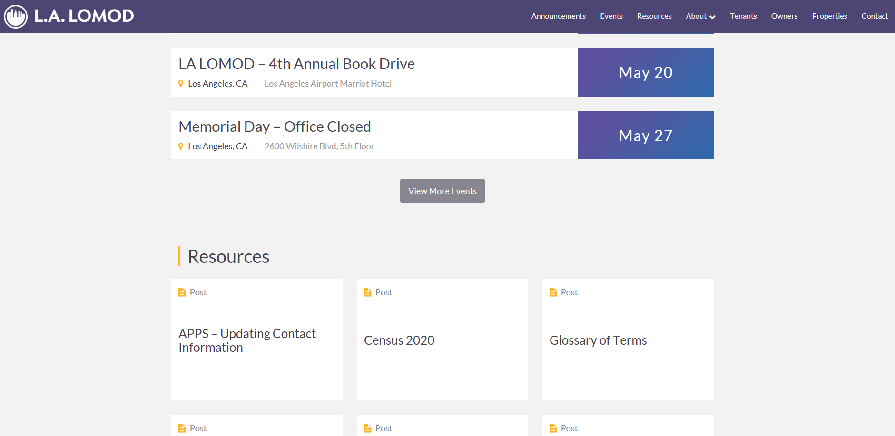
Census 2020
LOMOD Awareness Efforts

Slide 20
Census 2020
What you can do:
Talk to residents about Census
Put up Census Poster

Slide 21
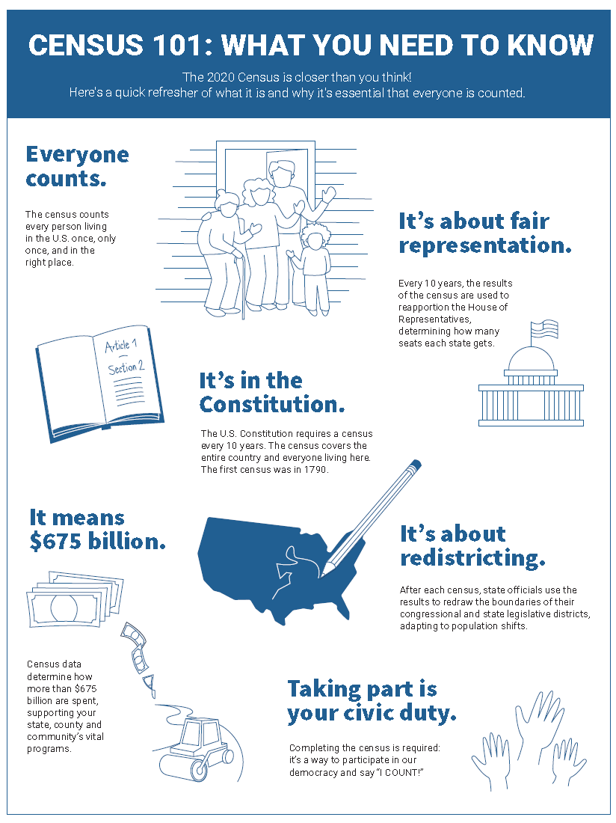
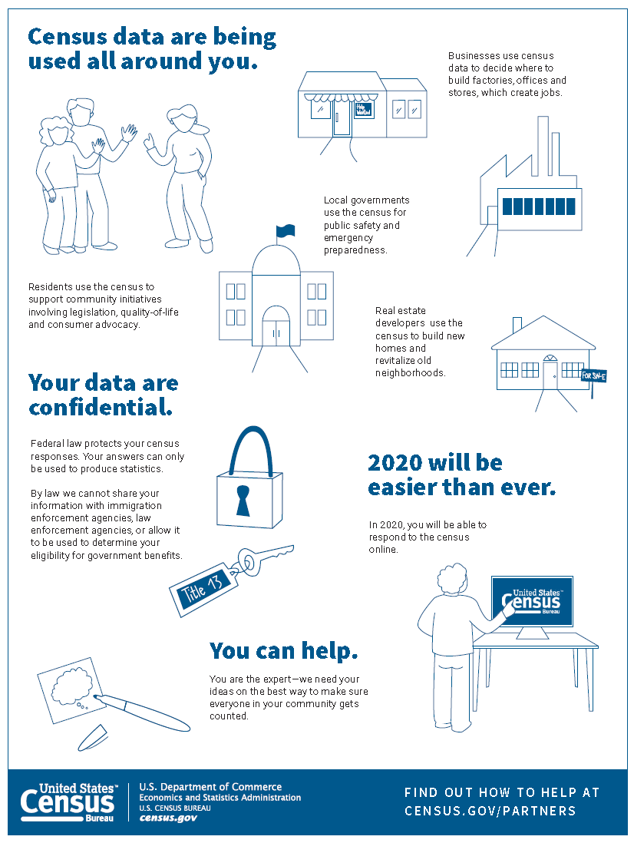

Slide 23
Meet & Greet 2019
Save the Date: July 29
InterContinental Downtown

