Slide 1
Waiting List Management

Slide 2
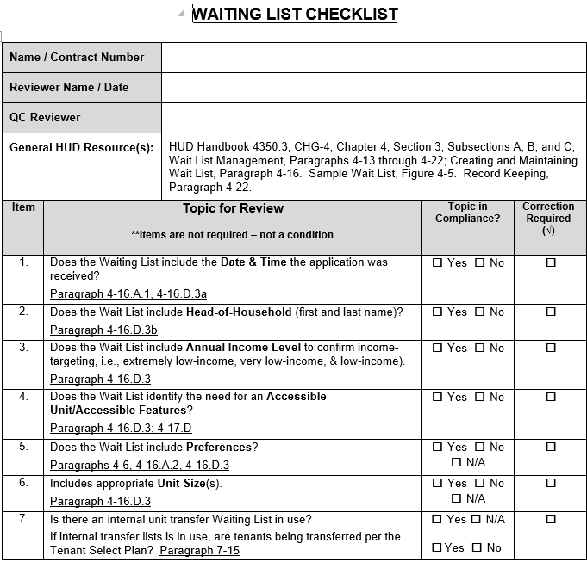

Slide 3
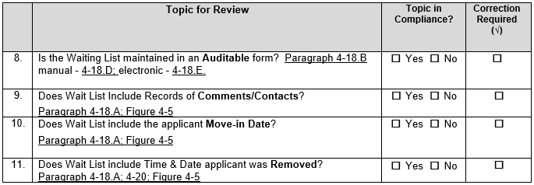

Slide 5
Resident was moved-in, but is showing as removed
No Move-in Date/Time
Actual Move-In date per 50059 = 3/13/18
Income marked as “Undetermined”

Slide 7
Missing Income Level
Missing need for accessible unit
Marked as Removed, but Applicant Moved-In
Missing time of Application
Missing correct contact information. If phone number was incorrect, was a letter sent?

Slide 9
Should not be “removed”
Missing

Slide 10
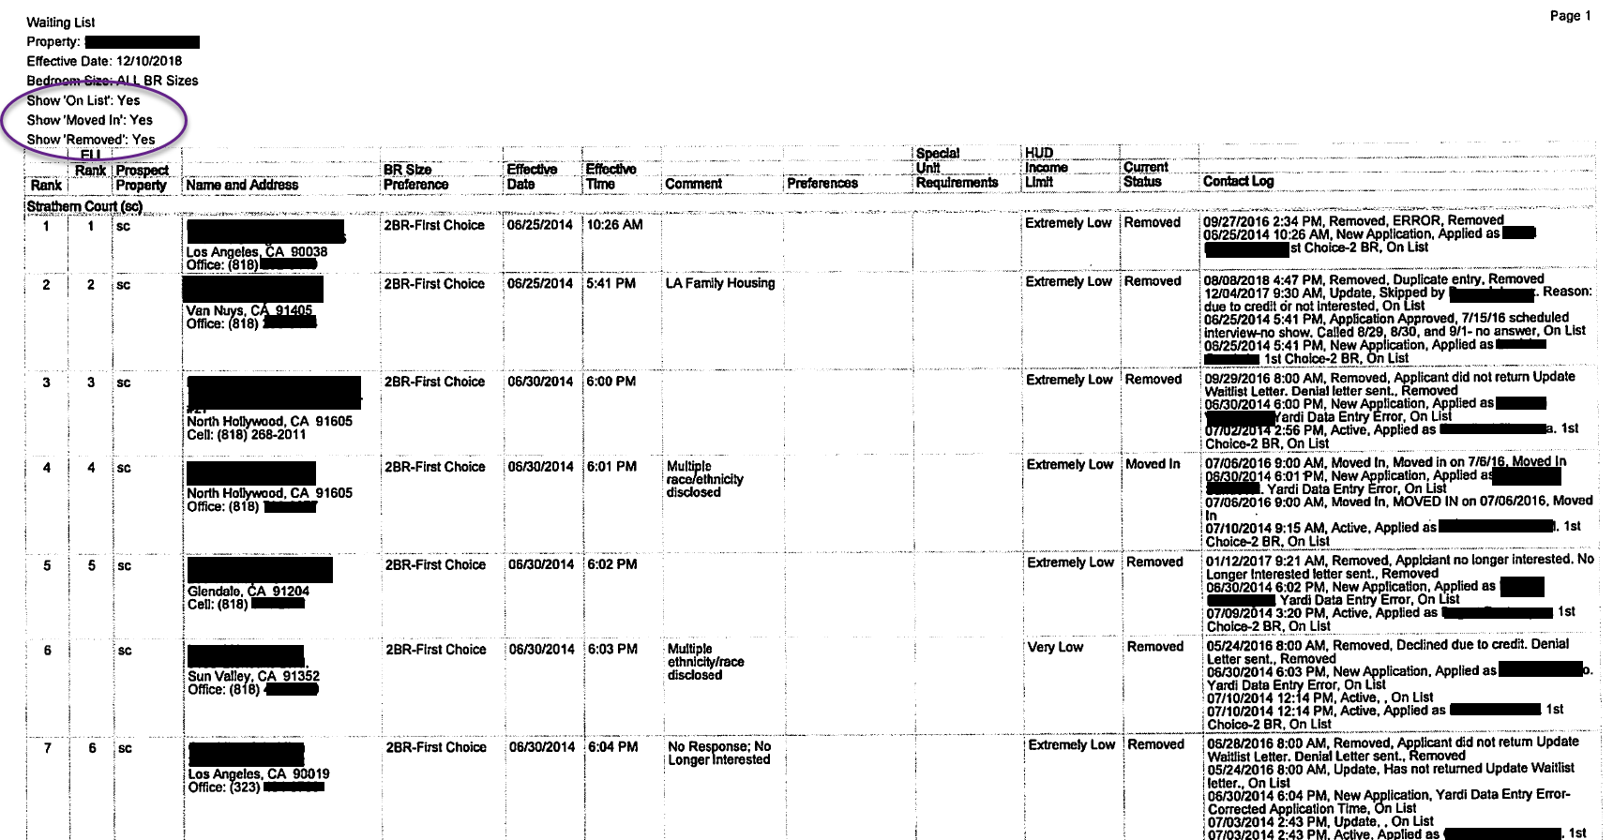

Slide 11
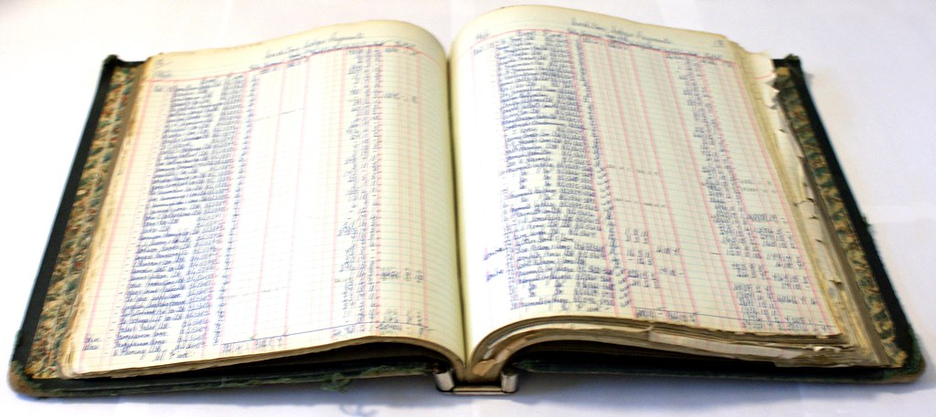
Go Electronic!
Do not handwrite corrections onto electronic waiting lists
Enter corrections into software and reprint the list
Make sure you click all the boxes!
All required WL fields, Notes, Comments, etc.
Ensure all applicant notes are updated
Explain why an applicant was skipped over
Don’t maintain two waiting lists (electronic and
manual)

Slide 12
Helpful Tips
Ensure the Waiting List provided includes:
All Move-in Tenant’s within the last 12 months
Removed / Rejected applicants
Active Applicants
Comments and notations are on the waiting list
Ensure the Waiting List is auditable
If your Tenant Selection Plan includes Preferences, make sure your Waiting List and Application both include a section for Preferences
The move-in date on the Waiting List must match the tenant move-in date on the HUD-50059

Slide 13
Helpful Tips – Special Claims
Most common reason a Special claim is rejected is the Waiting List
Not properly annotated
Why was an applicant “skipped over”
Previous contacts with applicant (date applicant was contacted, response of applicants and feasible actions to fill the vacany)
Reason for Rejection/Cancelation is not included

Slide 14
Management & Occupancy Reviews

Slide 15
MOR updates
HUD is looking to increase the frequency of MORs
2016 and 2017 MORs – expect to see us this year!

Slide 16
Preparing for your MOR
Review last MOR
Ensure all Findings / Corrective Actions have been addressed for all files
Review HUD Documents
EIV reports – are all reports within the last 12 months in the Master File?
EIV Rules of Behavior / Security Awareness Training for all staff using EIV
Have copies of all HUD approval of fees, lease addendums, mass recerts available

Slide 17
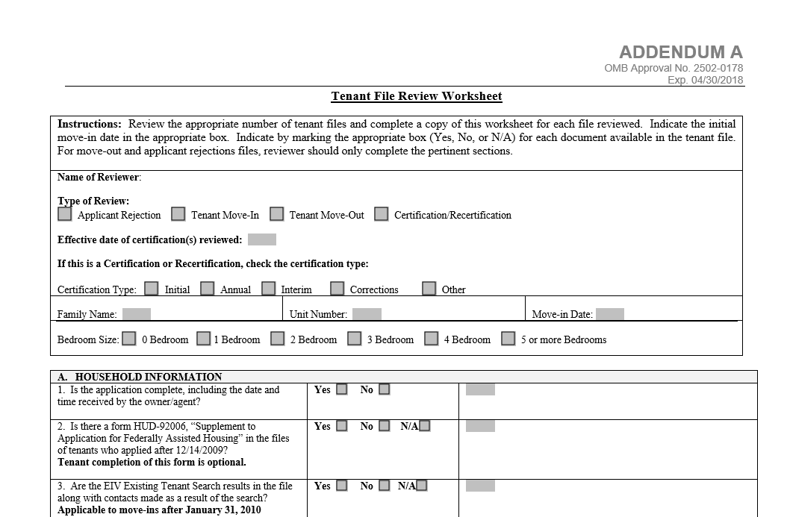
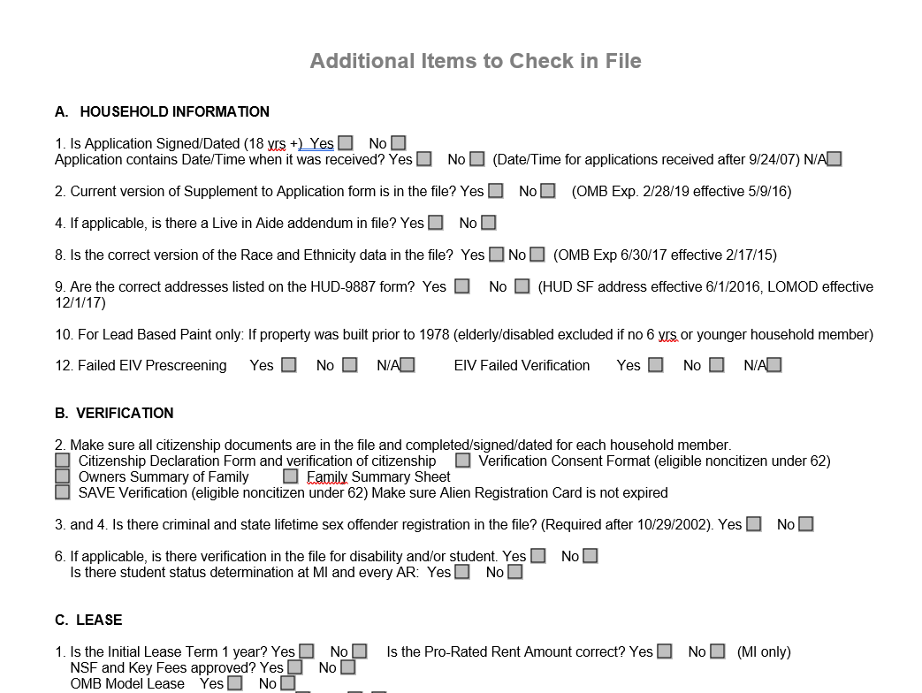
Preparing for your MOR
Perform mini-Audit

Slide 19
Common Findings – Debit Card for Benefits
Treat as a Savings Account (only looking at Cash value – not Food)
Obtain a receipt from ATM with amount on card
Remember – if a resident is receiving a government benefit (SSA, SSI, etc.) and does not have a bank account
How are they receiving their benefit?
If getting a paper check – have the resident self certify that they receive a check and then cash it

Slide 20
Common Findings – Sex Offender Screening
If no screening in file
File clarification is not sufficient
MUST run a screening

Slide 21
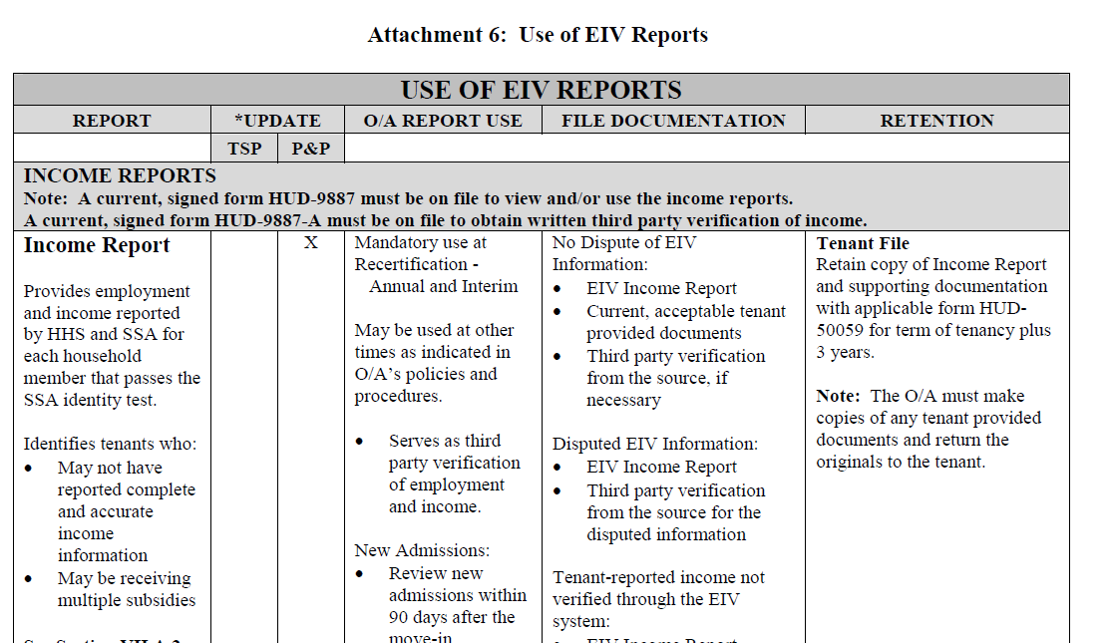
Common Findings – EIV Policy
Policy does not state:
Report Use
File Documentation
Retention
Notice H 2013-06
Attachment 6 can be incorporated into policy

Slide 22
Common Findings – Requests in Writing
Requiring any request / notice to be given in writing
Include statement that a reasonable accommodation can be made for those unable to submit in writing

Slide 23
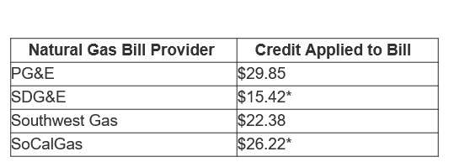
California Climate Credit
Natural Gas customers now receive a credit
Credit was given in October 2018 for:
PG&E
Southwest Gas
Retroactive credit for October 2018 given in April 2019 for:
SDG&E
So Cal Gas
2018 Climate Credit Amounts

Slide 24
California Climate Credit
Example 1
Resident has So Cal Gas and SCE
Moved into property on September 30, 2018 or earlier
2018 So Cal Gas - $26.22
2019 So Cal Gas - $24.01
2019 SCE - $33.00 x 2 = $66.00
Total Credit for 50059 = $116.23

Slide 25
California Climate Credit
Example 2
Resident has So Cal Gas and SCE
Moved into property on October 1, 2018 or later
2019 So Cal Gas - $24.01
2019 SCE - $33.00 x 2 = $66.00
Total Credit for 50059 = $90.01

